Slide 1


AI-Powered Cultural Bridge
TEAM NAME: COGNITIVE CREATORS
COMPANY NAME: BRIDGES FROM BORDERS

Slide 2

TEAM MEMBERS:
ANKIT DUBEY
SHLOKA BHATT
ARYA SATAM
MANEESHA KOMATI
MENTOR:
ADITHYA
AJIT PAWAR

Slide 3
TABLE OF CONTENTS
01
02
03
PROBLEM STATEMENT
WORKFLOW
DETAILED DESCRIPTION
04
05
AI MODEL DESCRIPTION
DEMO RESULTS

Slide 4
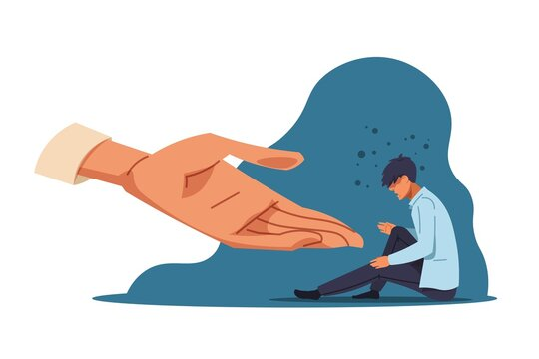
PROBLEM STATEMENT
BRIDGES FROM BORDERS
How to use AI to support human service/professional
service providers in multicultural competency
development.
OBJECTIVE
Enhance Cultural Understanding Through AI Suggestions and Live Q&A
Personalized Client-Provider Matching
Continuous Learning Through Feedbacks

Slide 5
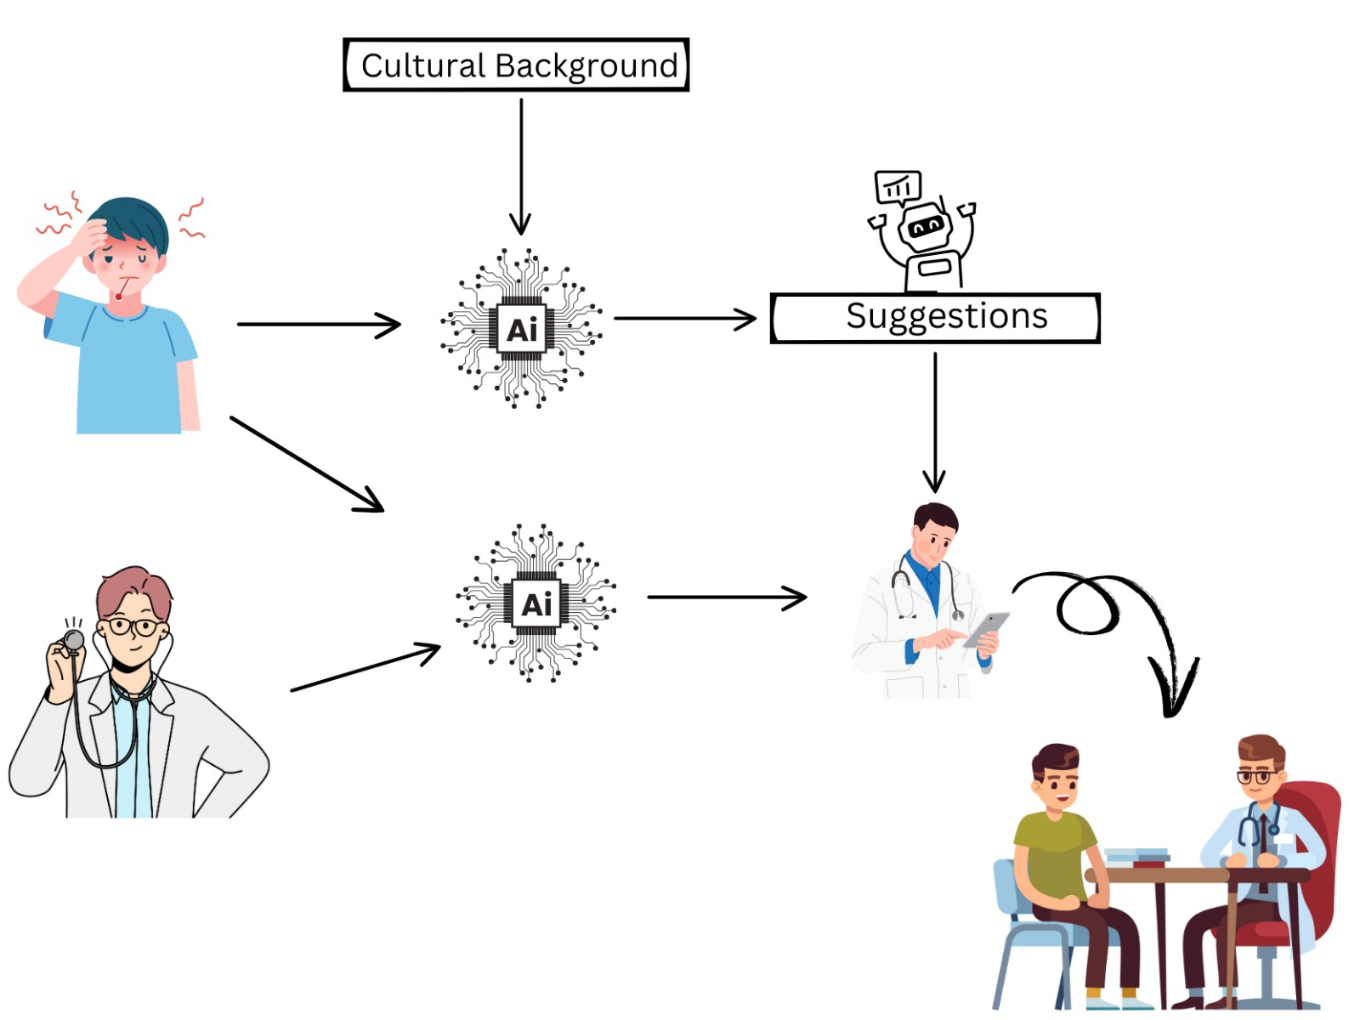
WORKFLOW

Slide 6
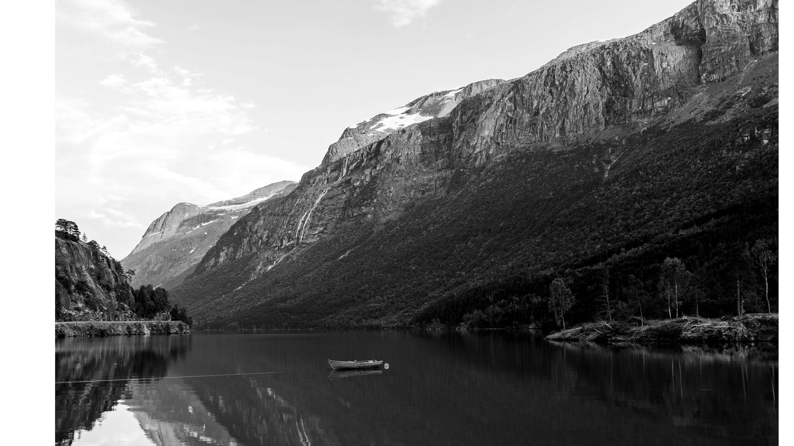
SECTOR NEWS
User Input and Preprocessing
MARS
DETAILED DESCRIPTION
1.
3.
Interactive Chatbot
2.
AI Suggestions
Capture inputs from both clients and service providers.
Use NLP for cleaning and structuring data. Map inputs to structured categories using advanced text embeddings for cultural context.
A responsive system that enables doctors to engage with clients based on previous interactions, leveraging historical data to provide tailored suggestions and enhance communication.
Advanced LLM Integration
Knowledge Graph Integration
Hybrid Recommendation System
Dynamic Cultural Adaptation Using Reinforcement Learning
Post-Session Feedback and Continuous Learning
Despite being red, Mars is a cold place, not hot. It’s full of iron oxide dust, which gives the planet its reddish cast
Technologies Used: React.js, Node.js, MongoDB

Slide 7
AI MODEL DESCRIPTION
Advanced LLM Integration
Using cultural data to fine tune the LLM model.
Implement few-shot learning to enhance the model's understanding of unique cultural contexts.
Customize the LLM to simulate culturally appropriate conversations for real-time guidance.
Knowledge Graph Integration
Use Neo4j or Amazon Neptune to map out cultural relationships, religions, and medical practices.
Utilize the knowledge graph during the provider-client matching process to understand deeper cultural connections.
Hybrid Recommendation System
Combining Approaches:
Collaborative Filtering: Use data from similar matches.
Content-Based Filtering: Consider individual attributes.
Use TensorFlow Recommenders for hybrid models that learn from past interactions.

Slide 8
AI MODEL DESCRIPTION
Dynamic Cultural Adaptation Using Reinforcement Learning
Feedback Loop: Implement RL to continuously improve the matching algorithm based on feedback.
Outcome Learning: Use frameworks like Ray RLlib to adapt recommendations based on session outcomes.
Post-Session Feedback and Continuous Learning
Collecting Feedback: Gather feedback from both clients and providers post-session to refine the model.
Training for Bias Reduction: Continuously train the model to reduce biases and improve accuracy in future matches.

Slide 9
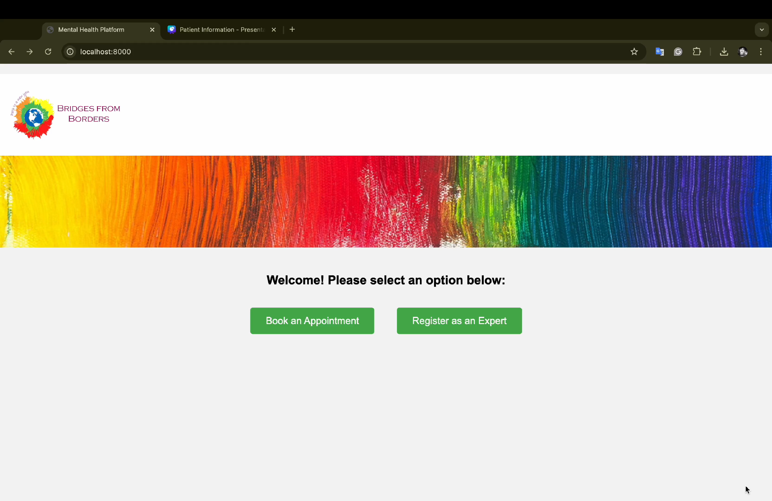

Slide 10
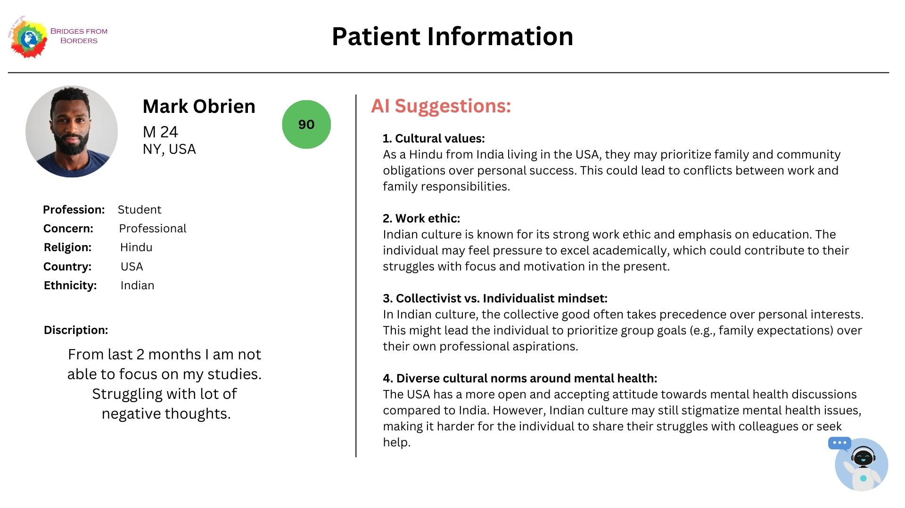

Slide 11
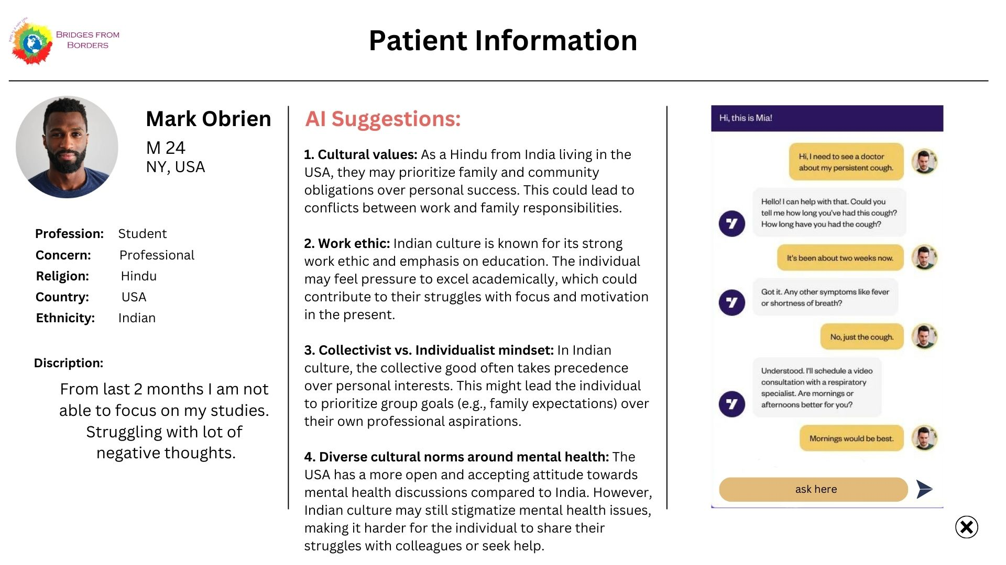

Slide 12

FUTURE SCOPE
Multimodal AI: Add voice and image recognition to analyze emotions and body language for better cultural understanding.
Global Language Support: Use multilingual NLP to enable seamless communication across languages.
AI-Powered Cultural Training: Create AI-based cultural training for service providers, improving with real-world feedback.
Behavioral Insights: Integrate sentiment analysis and behavioral tracking to improve predictive capabilities for client outcomes.

Slide 13

THANK
YOU

